Slide 1

JOB

Slide 2
JOB
Ca. 19th-17th century BC
Author:
Job, Elihu, Moses and Solomon

Slide 3

JOB
Bricklayer’s Accident Report

Slide 4
JOB
"The greatest poem of ancient or modern times"
Lord Alfred Tennyson

Slide 5
JOB
"There is nothing written, I think, in the Bible or out of it, of equal literary merit"
Thomas Carlisle

Slide 6
JOB
God is omnipotent
God is omni-benevolent
Two immutable truths

Slide 7
JOB
1) Reciprocity
2) Result of the Fall
3) Manifest God’s glory
4) Teach us lessons
Reasons we suffer

Slide 8
JOB
Job
Mrs. Job
Eliphaz
Bildad
Zophar
Elihu
Human Cast of Characters

Slide 9
JOB
I.
God vs. Satan (1-3)
II.
1st Round (4-14)
III.
2nd Round (15-21)
IV.
3rd Round (22-37)
V.
Job Meets the Lord (38-42)
Outline

Slide 10
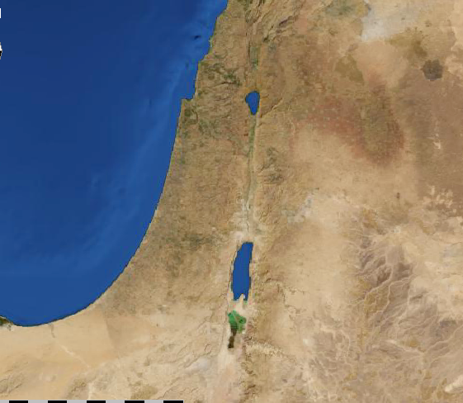
JOB
Where was Uz?

Slide 11
JOB
KJV, Daysman
NASB, Umpire
NIV, Someone to arbitrate
For there is one God and one Mediator between God and men, the Man Christ Jesus
1 Timothy 2.5

